Slide 1

Functions of Behavior
Behavior Technician Curriculum

Slide 2
Why Understanding Behavior Matters
Behavior always serves a purpose.
Knowing the function helps us respond effectively.
As behavior technicians, your interventions depend on understanding why the behavior occurs.

Slide 3
What is a Function of Behavior?
A function is the reason or purpose behind a behavior.
Behavior is communicative—it tells us something.
Understanding function = better behavior plans.

Slide 4
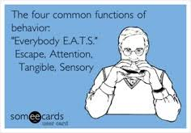
The 4 Main Functions of Behavior
The Big Four
Attention
Escape/Avoidance
Access to Tangibles
Automatic/Sensory

Slide 5
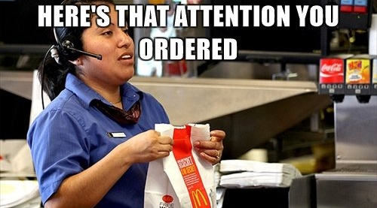
Behavior for Attention
The behavior gets social interaction (positive or negative).
Examples:
Calling out in class
Throwing objects to get a reaction
Doing something unsafe to get Mom to say “Don’t do that!!”
Tip: Even scolding can reinforce attention-seeking behavior.

Slide 6
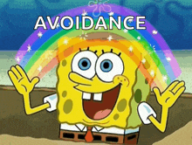
Escape/Avoidance
The behavior helps the individual avoid or escape a task, situation, or person.
Examples:
Running away when work is presented
Saying “I don’t know” repeatedly
Engaging in tantrums to delay tasks
Tip: Watch for patterns like behavior during specific activities.

Slide 7
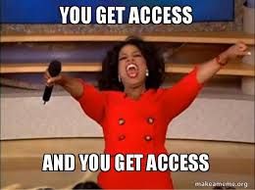
Access to Tangibles
Behavior to Get Something
The behavior results in getting an item or activity.
Examples:
Crying to get a toy
Hitting to get a snack
Taking someone’s phone
Tip: Reinforce communication as a replacement behavior.

Slide 8
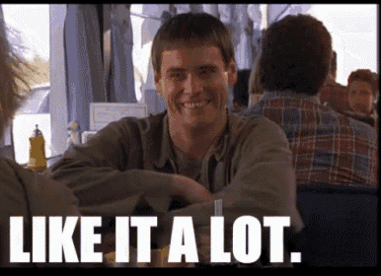
Automatic/Sensory
Behavior That Feels Good
The behavior feels good or regulates the body.
Examples:
Rocking back and forth
Hand-flapping
Putting playdoh on mouth ☺
Tip: These behaviors may occur even when alone.

Slide 9
Identifying the Function
How do we try to identify the function?
Observe the ABCs:
Collect data and look for patterns.
Collaborate with your BCBA!
Antecedent
what happens before
Behavior
the observable action
Consequence
what happens directly after

Slide 10
Why This Matters
Interventions must match the function.
Wrong guess = ineffective response
Right guess = behavior change and success!

Slide 11
Quick Review
Behavior always has a function.
The 4 functions are:
A_______
E_______
A_______ to T_________
A_______ / S________

Slide 12
Practice Activity!
You are working with client, Weston. You tell Weston “It’s time to read”. Weston starts crying.
What is the function / why might he be crying?
How should you respond to match the function?

Slide 13
Practice Activity!
You are working with Sam. Her Mom is working on her computer on the other side of the room. During playtime, Sam throw toys at her Mom. Her Mom stops working and says “stop it, Sam!!”
What is the function / why might he be crying?
How should you respond to match the function?

Slide 14
Questions & Discussion
Any questions?
Real-life examples of your client’s behavior?

